Slide 1
Neural Radiance Fields
by Aliaksandr Lemiasheuski
January 2024

Slide 2






based on paper NeRF: Representing Scenes As Neural Radiance Fields For View Synthesis, ECCV 2020
Ben Mildenhall
Pratul P. Srinivasan
Matthew Tancik
UC Berkeley
UC Berkeley
UC Berkeley
Jonathan T. Barron
Ravi Ramamoorthi
Ren Ng
Google Research
UC San Diego
UC Berkeley

Slide 3
Outline
01
Introduction
04
Process
02
Method
05
Quality
Problem description and solution overview
Emitted radiance, volume rendering
Scene representation, radiance field
Encoding, sampling, implementation details
03
Architecture
06
Evaluation
Input/output vectors, hidden layers, skip connections, etc.
Result comparison, conclusions

Slide 4
01
Introduction
Description of the addressed problem and overview of the applied approach

Slide 5
The Problem
The paper addresses a longstanding problem in computer vision and graphics, namely novel view synthesis.
Given a collection of input images we want to generate new views of the same scene from camera positions which do not appear in the input data.

Slide 6
The Approach
NeRF: Neural Radiance Fields
The NeRF method works by learning “radiance field” of a scene from each viewpoint by using differentiable volumetric rendering and minimizing a pixel-level photometric loss.
A neural network is used to represent the radiance field.

Slide 7
View Synthesis
Input images
Optimize NeRF

Slide 8
View Synthesis
Render new views

Slide 9
02
Method
NeRF scene representation and radiance field

Slide 10
Scene Representation
Continuous neural network (a continuous 5-dimensional vector function F_{Θ}) is used as a volumetric scene representation
F_{Θ} : (x, d) → (c, σ)
x = (x, y, z) | 3D location
d = (θ, φ) | 2D viewing direction
c = (r, g, b) | view-dependent color
σ | volume density

Slide 11
Scene Representation

Slide 12
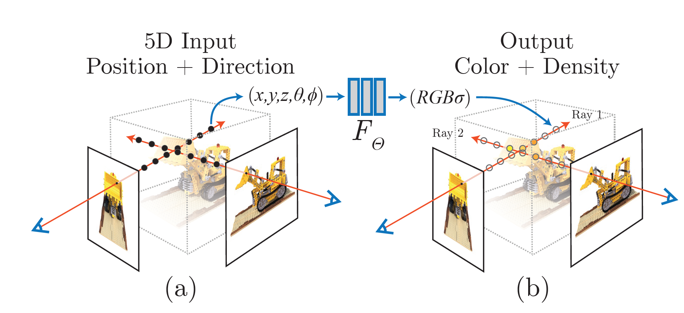
Generating View via Radiance Field
(a) Feeding location and viewing direction to the neural network
(b) Using volume rendering techniques* to composite these output values into an image
* Ray Tracing Volume Density, Kajiya et al, SIGGRAPH 1984

Slide 13

Method Intro by Matthew Tancik

Slide 14
03
Architecture
Input/output vectors, hidden layers, skip connections, etc.

Slide 15
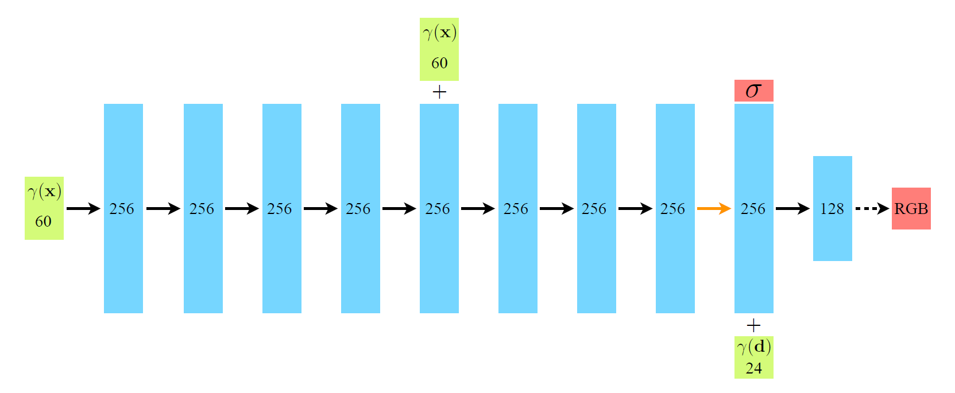
Network Architecture
NeRF method optimizes a deep fully-connected neural network without any convolutional layers (often referred to as a multilayer perceptron or MLP)
γ(x) | position coordinate after position encoding
γ(d) | view direction after position encoding
σ | volume density
RGB | emitted color

Slide 16
Network Architecture
60 | input vectors and their dimensions
256 | intermediate hidden layers and number of channel
 | output vectors
+ | vector concatenation
 | layers with ReLU activation
 | layers with no activation
 | layers with sigmoid activation

Slide 17
04
Process
Volume rendering, emitted radiance

Slide 18
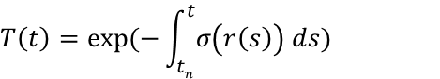
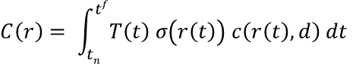
Volume Rendering with Radiance Fields
Rendering model for ray: r(t) = o + td, t_{f} ≤ t ≤ t_{n}
$$C\left(r\right)= \int_{tn}^{tf}{T\left(t\right) \text{σ}\left(r\left(t\right)\right) c\left(r\left(t\right),d\right) dt}$$
How much light is blocked earlier along the ray:
$$T\left(t\right)=exp⁡(−\int_{tn}^{t}{\text{σ}\left(r\left(s\right)\right) ds})$$

Slide 19
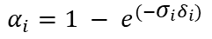
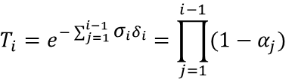
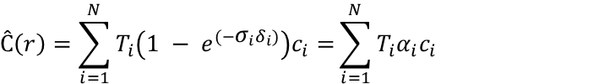
Volume Rendering with Radiance Fields
Rendering model for ray: r(t) = o + td, t₁ ≤ t ≤ t_{n}
$$Ĉ\left(r\right)=\sum_{i=1}^{N}{T_{i}\left(1 − e^{({−\text{σ}}_{i}δ_{i})}\right)c_{i}=}\sum_{i=1}^{N}{T_{i}α_{i}c_{i}}$$
How much light is blocked before reaching the segment:
$$T_{i}=e^{−\sum_{j=1}^{i−1}{{\text{σ}}_{i}δ_{i}}}=\prod_{j=1}^{i−1}{(1−α_{j})}$$
Amount of light emitted by the segment:
$$α_{i}=1 − e^{({−\text{σ}}_{i}δ_{i})}$$

Slide 20
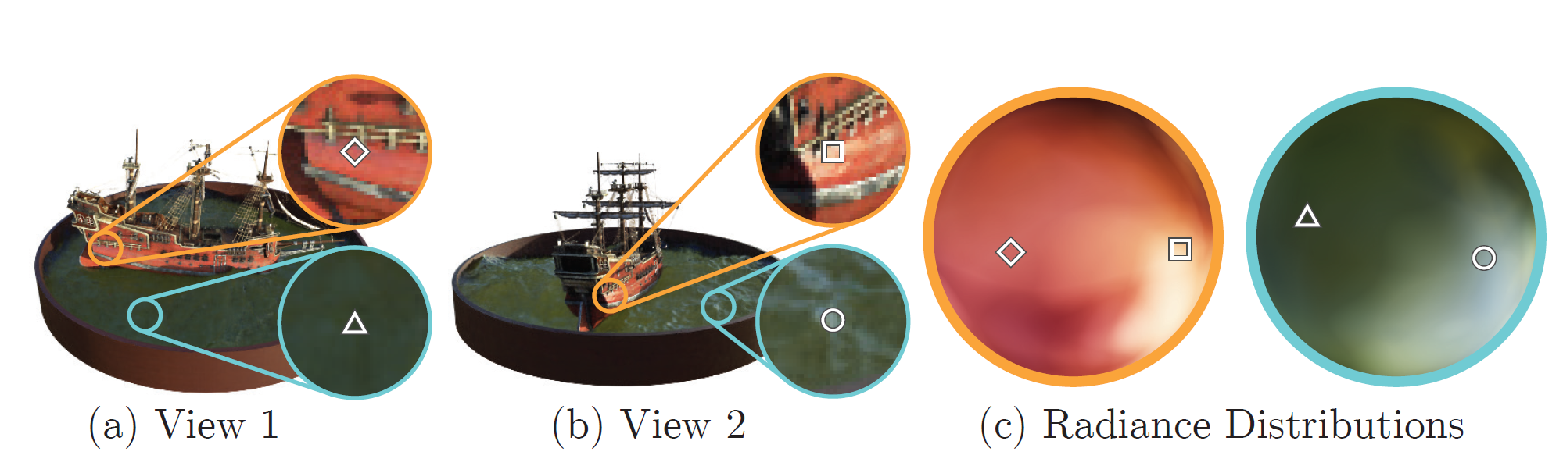
View-dependent Emitted Radiance

Slide 21
05
Quality
Positional encoding, hierarchical sampling, implementation details

Slide 22
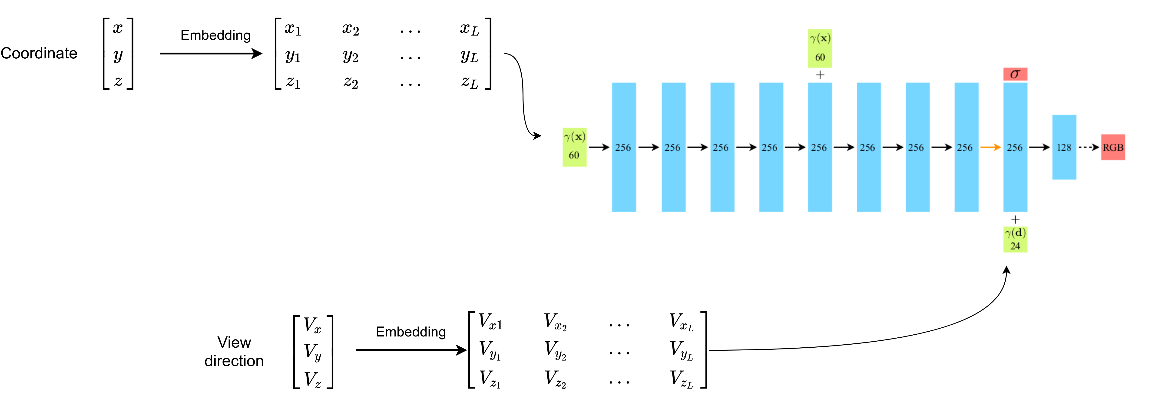
Positional Encoding
+ The input is mapped to high dimensional space before being sent into the network
+ This makes the network more adaptable to high frequency changes
$$γ\left(p\right)=(\sin\left(2^{0}πp\right), \cos\left(2^{0}πp\right), …, \sin\left(2^{L−1}πp\right), \cos\left(2^{L−1}πp\right))$$

Slide 23
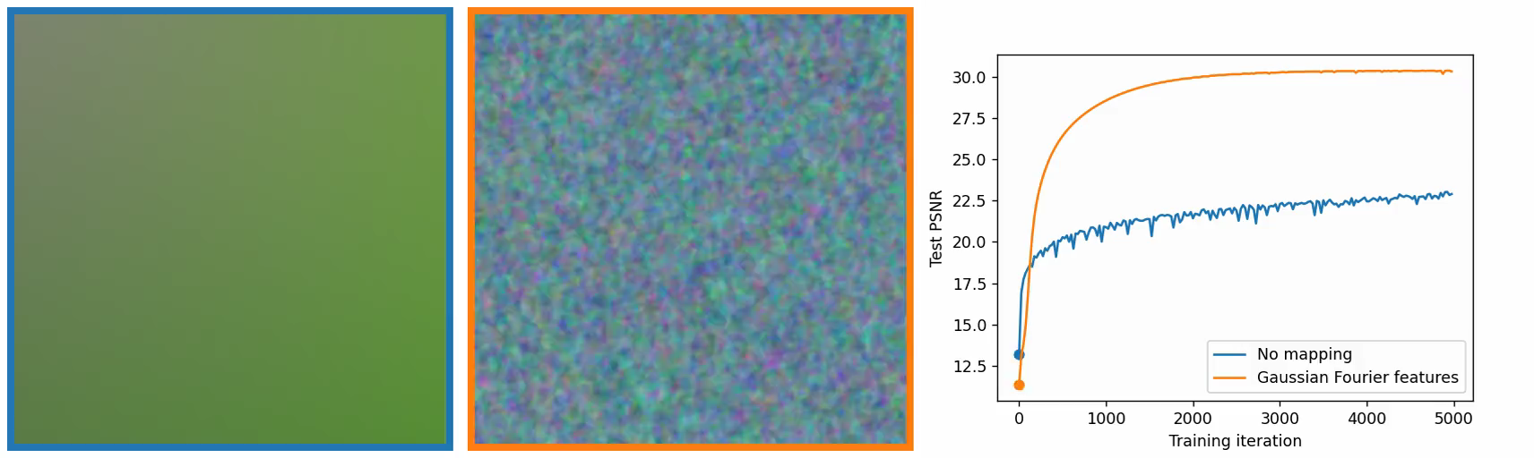
Positional Encoding

Slide 24
Hierarchical Volume Sampling
+ Two networks are optimized: one “coarse” and one “ﬁne”
+ The output of the coarse network is used to adjust the sampling for the ﬁne network

Slide 25
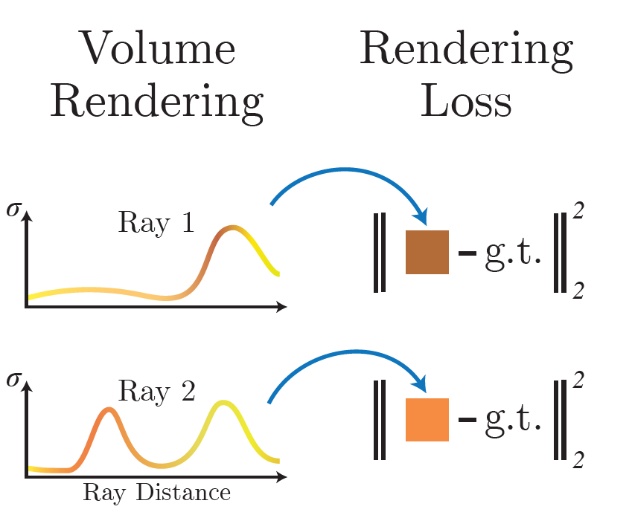
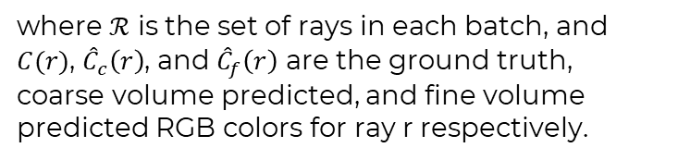
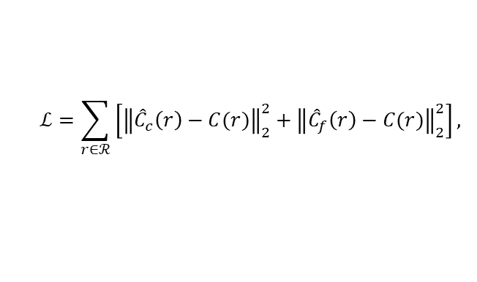
Implementation Details
+ Loss function $ℒ$ : Our loss is simply the total squared error between the rendered and true pixel colors for both the coarse and ﬁne renderings
$$ℒ=\sum_{r∈ℛ}{\left[{\left\|{\hat{C}}_{c}\left(r\right)−C(r)\right\|}_{2}^{2}+{\left\|{\hat{C}}_{f}\left(r\right)−C(r)\right\|}_{2}^{2}\right]},$$
where $ℛ$ is the set of rays in each batch, and $C(r)$, ${\hat{C}}_{c}\left(r\right)$, and ${\hat{C}}_{f}\left(r\right)$ are the ground truth, coarse volume predicted, and fine volume predicted RGB colors for ray r respectively.

